Slide 1
Personal Exposure to Polybrominated Diphenyl Ethers (PBDEs) in Residential Indoor Air
Joseph G. Allen, Michael D. McClean, Heather M. Stapleton, Jessica W. Nelson, and Thomas F. Webster
Presented by Shaina Stacy
December 2010

Slide 2
Outline of Presentation
Background
Structure, commercial uses, exposure pathways and previous studies
Study Objectives
Methods
Area and personal air sampling, laboratory analysis, survey of home characteristics and data analysis
Results and Conclusions
Strengths
Limitations
References

Slide 3
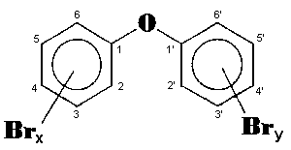
Background: Polybrominated Diphenyl Ethers (PBDEs)
http://www.inchem.org/documents/ehc/ehc/ehc162.htm
Hydrophobic
Persistent in the environment
Bioaccumulate in humans and biota
Used as fire retardants in consumer products

Slide 4
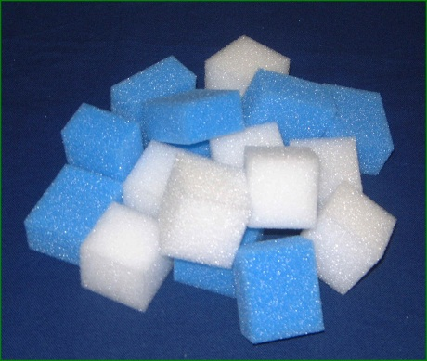
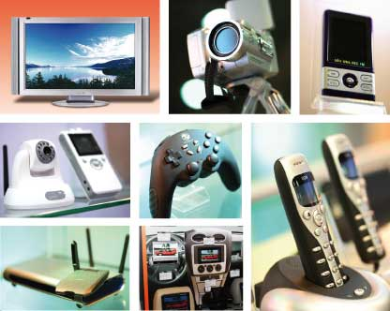
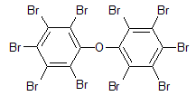
Background: Commercial Use
PBDEs: http://www.chemicalbook.com and http://www.sinoharvest .com; Products: http://www.8linx.com/cnc/polyurethane_foam.htm and http://tradeshow.globalsources.com/TRADESHOW/DUBAI-ELECTRONICS/VISITOR.HTM
Notes:
These are structures of the PBDEs most commonly used in commercial products. At the top is a penta-brominated diphenyl ether, which is used in polyurethane foam. There are many possible arrangements of the bromine groups on the aromatic rings; this is only one possible structure. The bottom two are octa- and deca-BDEs, which are used in electronics. Deca-BDE is also called BDE-209.

Slide 5
Background: PBDE Exposure Pathways and Possible Effects
Possible routes of exposure
Inhalation, dust ingestion and dermal absorption
Possible harmful effects
Unknown effects in humans
Endocrine disrupting and developmental neurotoxic effects in animal studies

Slide 6
Background: Previous Studies
Association between penta-like PBDEs in dust collected from residences of first-time mothers and PBDE concentrations in breast milk
Limitations of previous studies:
Did not measure concentrations of BDE 209 in homes
Were not done in the United States
Used passive sampling methods, which undersample particulates
Collected area samples, which underestimate exposure

Slide 7
Study Objectives
To quantify indoor air exposure to PBDEs in the home using both personal and ambient air sampling methods
To address limitations of previous studies as outlined on the last slide

Slide 8
Methods
Description of study
20 urban residences in the Greater Boston area in MA, both single- and multi-family
Sample based on willingness to participate (nonrandom)
January to March 2006
Used both personal and area air sampling methods
Air sampling pumps connected to air sampling media
Air sampling media consisted of: 1) Glass fiber filter (GFF) for capture of particulate-bound PBDEs and 2) Polyurethane foam (PUF) plug for capture of vapor-phase PBDEs

Slide 9
Methods
Area samples
Taken in rooms where people spend most of their time when they’re at home, the bedroom and the main living area (living or family room)
Air sampling apparatus mounted on tripods
Personal air samples
Pump worn in hip-pouch with sampling media clipped to shirt collar
Placed near bed at night with sampling media as close to breathing zone as possible

Slide 10
Methods
Details of air sampling
Two area samples and one personal air sample collected per residence and collected at the same time during a one-week period
Turned on all three pumps in evening after work and turned them off in the morning
All pumps turned off if person left at any time in the evening and turned on when he or she came back

Slide 11
Methods
Laboratory analysis
Used an automatic pressurized fluid extractor to extract GFFs and PUFs
Extraction of GFFs using HPLC-grade dichloromethane
Extraction of PUFs using HPLC-grade petroleum ether
Gas chromatograph coupled to a mass spectrometer used to analyze PBDEs in extracts

Slide 12
Methods
Survey of home characteristics
Walk-through by investigators to measure surface area, volume, and carpet floor coverage
Questionnaire administered to collect other home characteristics:
Age and type of dwelling
Heating
Window use
Frequency of and equipment used for house cleaning
Inventory of furniture and electronics in main living area and bedroom

Slide 13
Methods
Data Analysis
Limits of detection (LOD): Calculated as three times the standard deviation of the field blanks, with values < LOD assigned value of ½ LOD
Log-normally distributed, so statistical analysis utilized the natural log-transformed data
Alpha = 0.05
Univariate descriptive statistics, Spearman and Pearson correlations, scatterplots, simple linear regression, paired t-tests, and exploratory factor analysis

Slide 14
Results and Conclusions
Notes:
This is a table of summary statistics for PBDE concentrations in personal, bedroom and main living area air. BDEs 47, 99 and 209 had the highest concentrations in personal air. The geometric mean concentration in personal air was 766 pg/m3 for all BDEs and 469 pg/m3 for non-209 BDEs. Geometric Mean total BDE concentrations were higher in personal air compared to bedroom and main living area air.

Slide 15
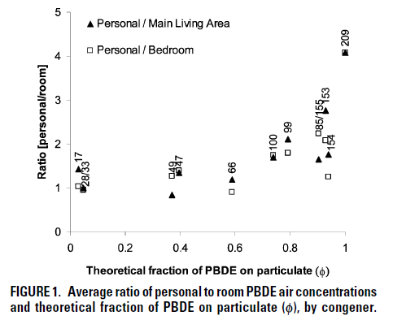
Results and Conclusions
Personal cloud effect:
Affects personal inhalation exposure
Influenced by individual activity patterns, e.g. resuspension of dust
As ɸ (the theoretical fraction on particulate) increases, the ratio of personal to room air increases.
Increased differences between personal air and room air as the degree of bromination increases are consistent with a personal cloud effect. The degree of bromination corresponds with a greater likelihood of partitioning to particulate, and resuspension by human activity.
Notes:
Figure 1 shows a plot of the average ratio of personal to room PBDE air concentrations versus the theoretical fraction of PBDE on particulate, which was found in the literature. For BDEs 17 and 28, which are lower brominated congeners found mostly in the vapor phase, the ratio is 1, indicating that there is no difference between personal and room air. For BDEs 99 and 153, which are more likely to be found in the particulate phase, the ratio is 2. For BDE 209, which is found almost entirely in the particulate phase, the ratio is 4.

Slide 16
Results and Conclusions
No statistically significant associations were found between PBDE concentrations in indoor air and the home characteristics mentioned earlier (furniture, electronics, cleaning habits, etc.). These results were consistent with those from other studies.

Slide 17
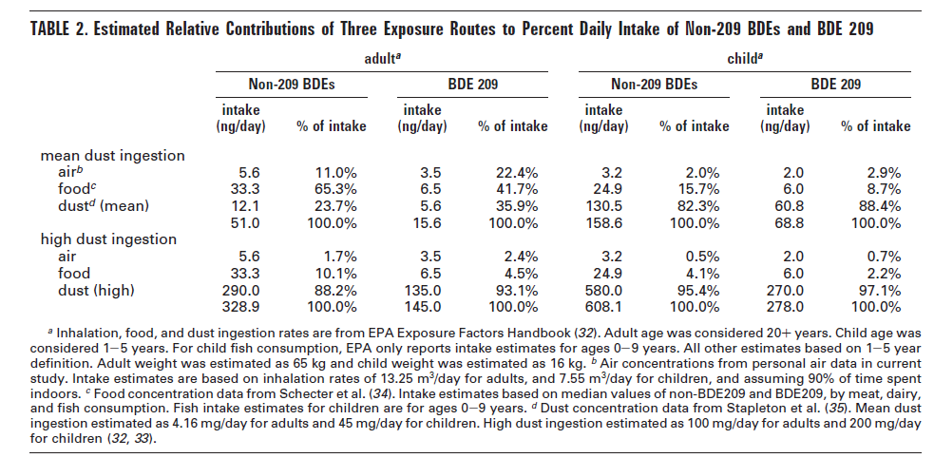
Results and Conclusions
Notes:
Table 2 shows estimated relative contributions of three exposure routes to percent daily intake of non-209 BDEs and BDE-209. The exposure routes considered were inhalation, ingestion of food and ingestion of dust, and estimates were made for both adults and children. Due to the large uncertainty for estimates of incidental dust ingestion, the contributions of each route were estimated using mean and high dust ingestion rates. The authors estimated the contribution of air using the mean or high dust ingestion rate and the personal air concentrations from this study. The contributions of food and dust ingestion were estimated using literature values. For children, inhalation exposure contributes less than 3% to total exposure regardless of whether the mean or high dust ingestion rate was used. For adults, using high dust ingestion estimates gives an inhalation contribution of 1.7% for non-209 BDEs and 2.4% for BDE 209. Using mean dust ingestion estimates suggests a much larger contribution: 11% for non-209 BDEs and 22% for BDE 209. The investigators concluded that inhalation may account for up to 22% of the total BDE 209 exposure in U.S. adults.

Slide 18
Strengths of Study
Obtained a better estimate of personal exposure to PBDEs through the use of personal, portable air sampling method
Sampling methods were noninvasive and relatively convenient.
It may have been somewhat inconvenient to have to remove the air pump if the person left the house during the evening as well as using it at night.
However, since they used willing participants, they may have been more likely to adhere to the expectations required of them.

Slide 19
Limitations of Study
According to the authors:
Estimates of inhalation exposure may be low because contributions of outdoor and workplace exposure were not included
Difficulty of direct measurement of dust ingestion and uncertainty surrounding dust ingestion rates
Estimates of the contribution of inhalation and dust ingestion to total PBDE exposure are limited
Without knowledge of body burdens of PBDEs for participants in this study, the most important route of PBDE exposure could not be empirically determined.

Slide 20
Limitations of Study
My thoughts:
Estimated that people spend 90% of their time indoors and 10% outdoors.
Working adults do not spend 90% of their time indoors at home. Although this study was an important step in characterizing PBDE exposure at home and in the United States, including other microenvironments would give a more complete picture of PBDE exposure.

Slide 21
Limitations of Study
The sample used was nonrandom. There may be an important difference between those that chose to participate in the study and those that did not, which may have affected the results.
Values < LOD were given a value of ½ LOD. A better approach would have been to impute these values using software.
Future studies could also include comparisons of indoor residential PBDE exposure between urban, suburban and rural areas.

Slide 22
References
Allen, J. G., McClean, M. D. Stapleton, H. M., Nelson, J. W., & Webster, T. F. (2007). Personal Exposure to Polybrominated Diphenyl Ethers (PBDEs) in Residential Indoor Air. Environ. Sci. Technol., 41, 4574-4579.

